Slide 1
Type provider treasure hunt
Rachel Reese | Jet.com
@rachelreese | http://rachelree.se | http://techgroup.jet.com

Slide 2
Why F#?
A brief history

Slide 3
Programming languages evolve just like regular languages.

Slide 4
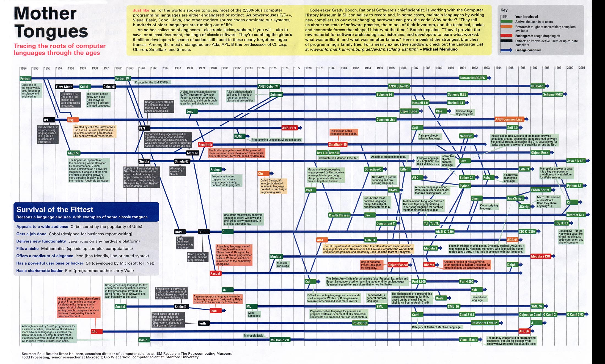
C#
F#

Slide 5
Why F#?
Testimonials

Slide 6
I have now delivered three business critical projects written in F#. I am still waiting for the first bug to come in.
- Simon Cousins
UK-based power company
Notes:
Fewer bugs come from less code.

Slide 7
The F# solution offers us an order of magnitude increase in productivity
- Yan Cui
Lead server Engineer, Gamesys

Slide 8
The F# code is consistently shorter, easier to read, easier to refactor and contains far fewer bugs.
- Kaggle, a predictive modelling company
Notes:
Fewer bugs come from less code.

Slide 9
All of this seems incredible, right?

Slide 10
So why doesn’t everyone use F#?

Slide 11
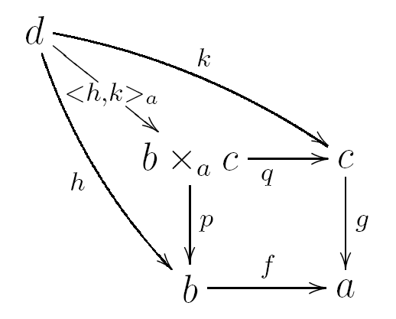

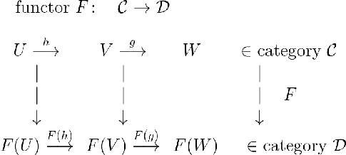
There’s a lot of math behind programming languages like F#.
Notes:
And in some FP communities, people really like to talk about the math.
And how important it is to properly understand it.
Before you can begin to code.

Slide 12
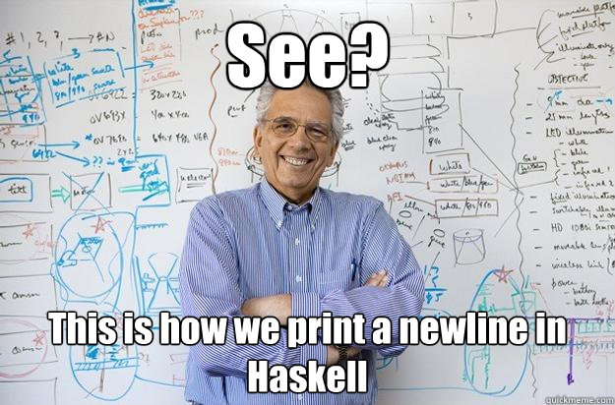

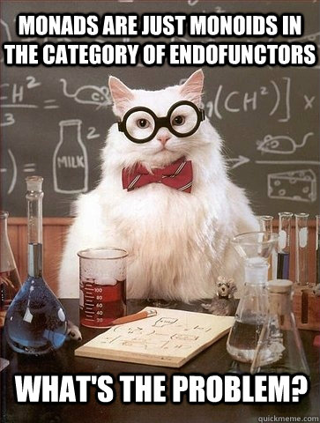
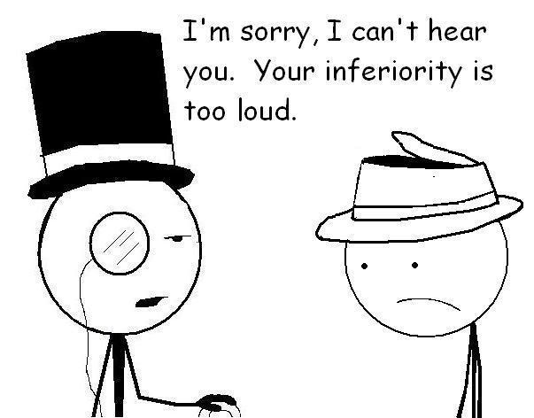

So they have this reputation.

Slide 13

This is Sean.

Slide 14
Sean is 8.

Slide 15
Sean spoke at a 2000-person technical conference this year. On F#.

Slide 16
Why F#?
Concise code & expanded feature set

Slide 17
Concise code
C# - 23 lines
F# - 10 lines
using System.Net using System using System.IO class WebPageDownloader { public TResult FetchUrl<TResult>( Func<string, StreamReader, TResult> callback, string url) { var req = WebRequest.Create(url); using (var resp = req.GetResponse()) { using (var stream = resp.GetResponseStream())
{ using (var reader = new StreamReader(stream)) { return callback(url, reader); } } } } }
open System.Net open System open System.IO let fetchUrl callback url = let req = WebRequest.Create(Uri(url)) use resp = req.GetResponse() use stream = resp.GetResponseStream() use reader = new IO.StreamReader(stream) callback reader url
From Comparing F# with C#, fsharpforfunandprofit.com
Notes:
Let’s see an example.
From fsharpforfunandprofit.com

Slide 18
Concise and powerful code
C#
F#
Same info as C#!
public abstract class Transport{ } public abstract class Car : Transport { public string Make { get; private set; } public string Model { get; private set; } public Car (string make, string model) { this.Make = make; this.Model = model; } } public abstract class Bus : Transport { public int Route { get; private set; } public Bus (int route) { this.Route = route; } } public class Bicycle: Transport { public Bicycle() { } }
type Transport = | Car of Make:string * Model:string | Bus of Route:int | Bicycle
Trivial to pattern match on!
Notes:
Option type is a simple discriminated union.
Both are idiomatic.
C# version still lacks structural equality (based on contents): that means overriding the equality implementation, the comparison implementation, AND GetHashCode. (generates a hash code from your object instance).
Also not proper immutability because private set is still mutable. To get real immutability, there should be no setter, and the backing field should be readonly.
Pattern matching is like a switch statement, but WAY more powerful.

Slide 19
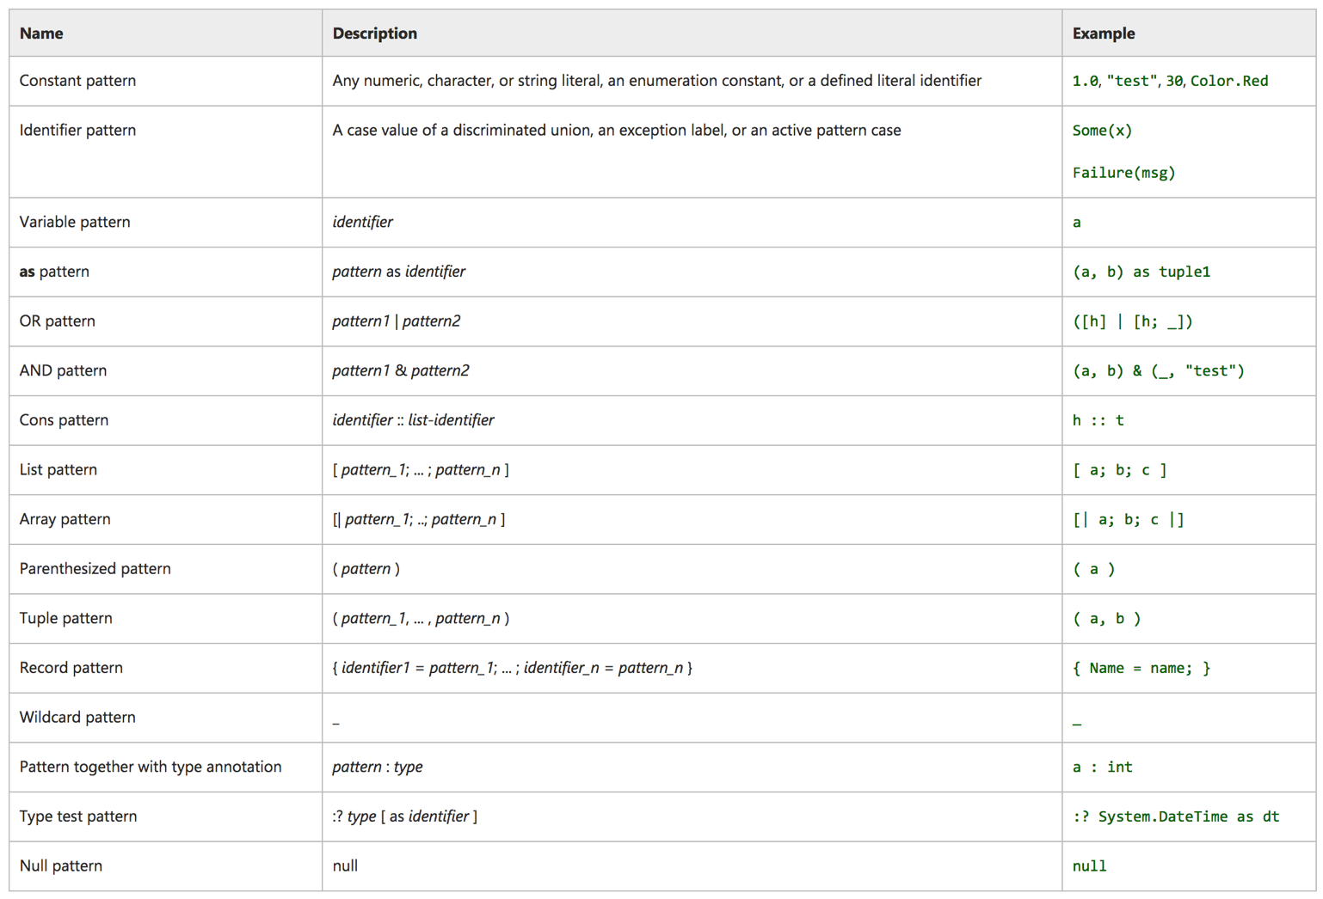
C#
F# pattern matching

Slide 20
Concise and powerful code
C#
F#
public abstract class Transport{ } public abstract class Car : Transport { public string Make { get; private set; } public string Model { get; private set; } public Car (string make, string model) { this.Make = make; this.Model = model; } } public abstract class Bus : Transport { public int Route { get; private set; } public Bus (int route) { this.Route = route; } } public class Bicycle: Transport { public Bicycle() { } }
type Transport = | Car of Make:string * Model:string | Bus of Route:int | Bicycle
let getThereVia (transport:Transport) = match transport with | Car (make,model) -> ... | Bus route -> ...
Warning FS0025: Incomplete pattern matches on this expression. For example, the value 'Bicycle' may indicate a case not covered by the pattern(s)
Notes:
Option type is a simple discriminated union.
Both are idiomatic.
C# version still lacks structural equality (based on contents): that means overriding the equality implementation, the comparison implementation, AND GetHashCode. (generates a hash code from your object instance).
Also not proper immutability because private set is still mutable. To get real immutability, there should be no setter, and the backing field should be readonly.
Pattern matching is like a switch statement, but WAY more powerful.

Slide 21
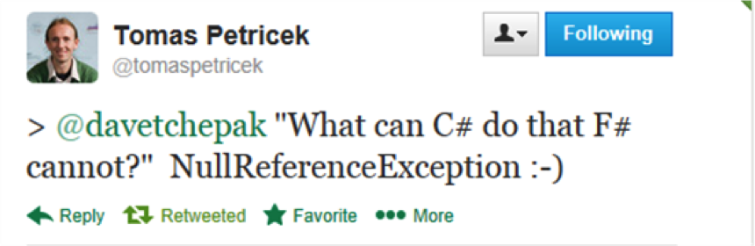
Expanded feature set: Option types
Notes:
NullReferenceException can be obviated because of option types.
Similar to nullable<int> but different because:
Can be used on any type (strings, functions)
When pattern matched on, forces you to consider None case
Can use map, iter, etc. functions.
Nestable: Option<Option<int>> is valid.

Slide 22
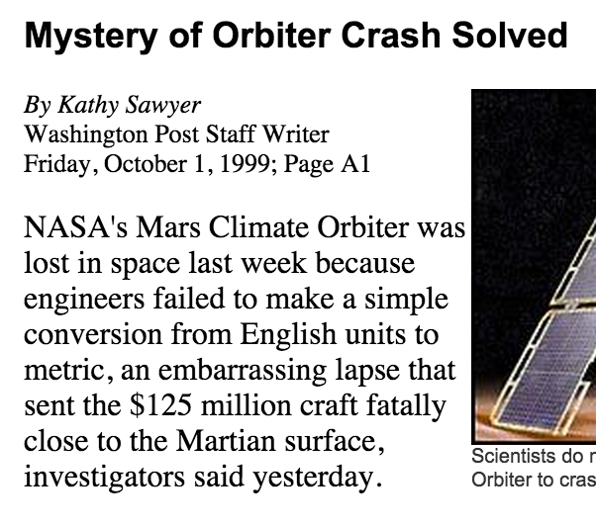
Units of Measure

Slide 23
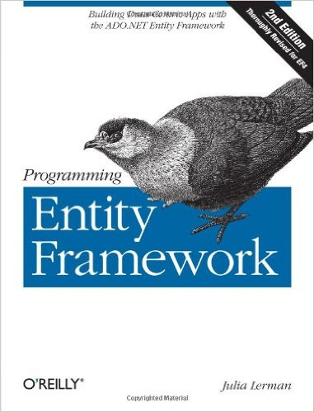
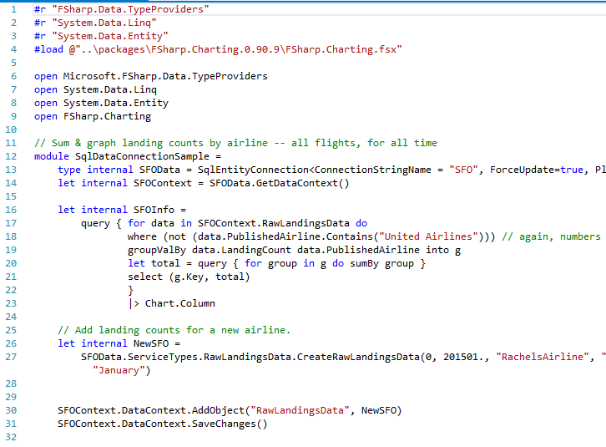
Expanded feature set: Type providers
920 pages!
31 lines!

Slide 24
Why F#?
Dependencies
Notes:
Let’s back up a minute.

Slide 25
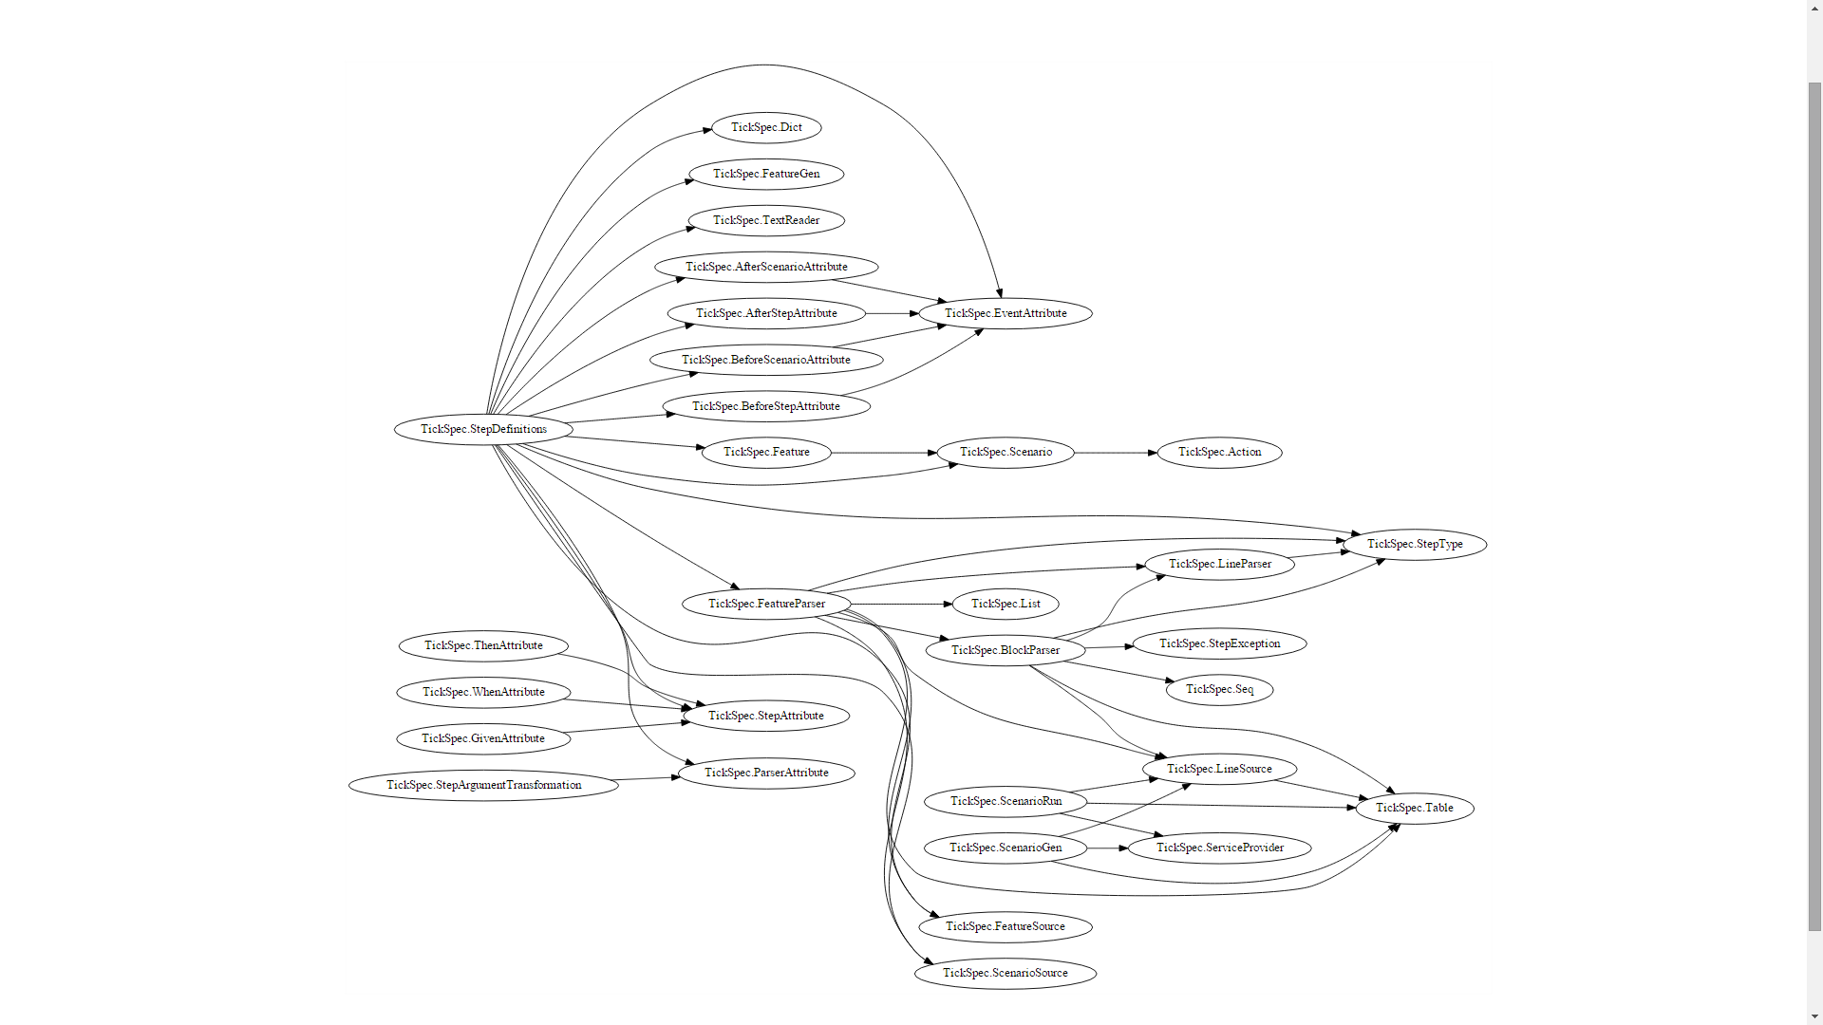
TickSpec – a lightweight BDD Framework for F#
Thanks to Scott Wlaschin for his post, Cycles and modularity in the wild
Notes:
BDD framework
E.g.: TickSpec: StepDefinitions depends on TickSpec: Feature

Slide 26
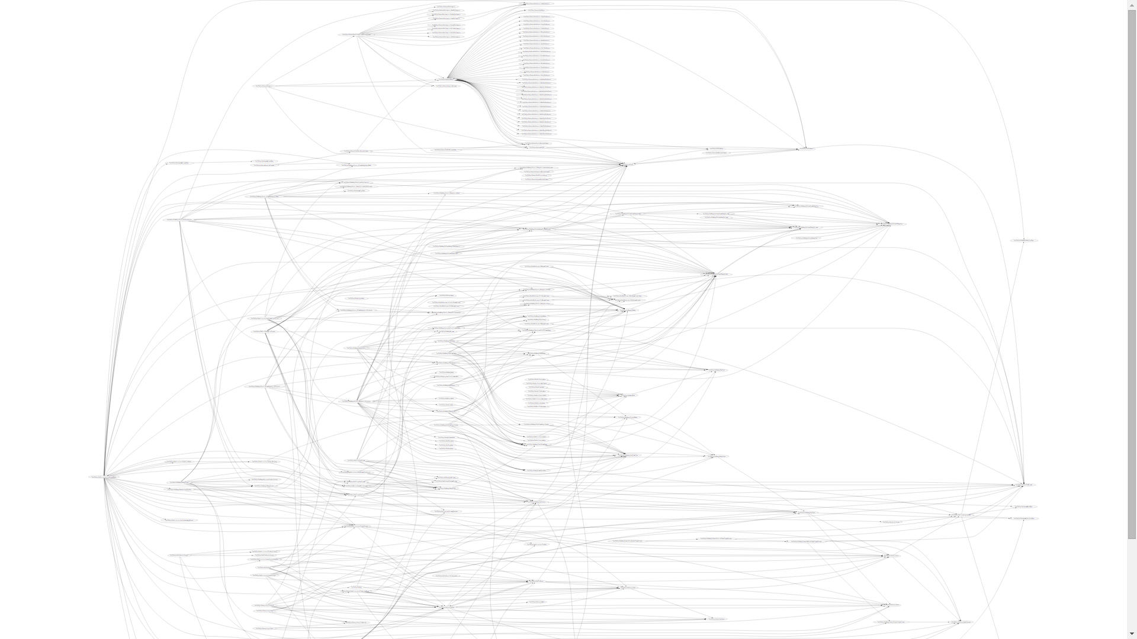
SpecFlow– a comparable C# project
Thanks to Scott Wlaschin for his post, Cycles and modularity in the wild

Slide 27

Entity Framework (C#)
Thanks to Scott Wlaschin for his post, Cycles and modularity in the wild

Slide 28
REPL
Bindings
Scalars
Functions
Scripting
Variables
Ref cells
Looping
Modules
Lists
Tuples
Records
Pattern matching
Sequences
Maps & sets
Higher-order functions
Options
Discriminated unions
Units of measure
Comprehensions
Recursion
Using type providers
LINQ
Pragmas
Project system
Attributes
Interfaces
Object expressions
Primary constructors
Extension members
Generic constraints
Continuation passing
Error handling
Choice workflows
Active patterns
Arrays
Async workflows
Mailbox processors
Inheritance
Custom operators
Computation expressions
Quotations
Platform invoke
Custom numeric literals
Inlining
Member constraints
Compiler service
Authoring type providers

Slide 29
Script Files & REPL
Significant whitespace
Type inference
Notes:
Create a script file, go over units of measure code.

Slide 30
Working with script files & the REPL
Write a function that calculates the area of a triangle
Area = 0.5 * (base * height)
Calculate the area when base = 5, height = 8.

Slide 31
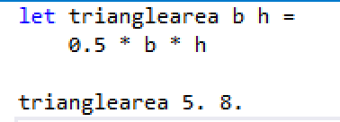
Script files & REPL: Answer

Slide 32
Type Providers!

Slide 33

What are type providers?
A mechanism to provide types to the compiler.
Notes:
A compiler plug in.
Get typed data into your code at design time. → Excel, csv, wsdl, xaml, sql server.
Good way to bring in other languages to F#. → Python, R, Matlab.

Slide 34

Why do we need type providers?
Because data!
Notes:
World is information-rich! Exploration is fun! Big data!
Data has a form to it, a schema. Losing that while you’re playing around is :(

Slide 35


Why do we need type providers?
Obtain data
Create infrastructure
Actually consume data
Set up connection
Because current data consumption methods.
Notes:
Type providers are literally 1-2 lines of set up.

Slide 36
Why do we need type providers?
More natural with REPL
Intellisense, tooltips, & other tooling available
Scalable to millions of types (e.g. – world bank)
No extra bloated code
Always in sync with the source
No code generation
Because: simplicity, elegance, & tooling
Notes:
REPL -> Discovery.
No Code Gen -> EF
EF type provider generates all the EF files, but does the generation in memory, then merges the resultant IL into your code, and cleans up after itself. No need to maintain all the EF leftover files.

Slide 37
Type provider Demo
World Bank/R
World Bank/JSON
Powershell

Slide 38
Let’s get started
Split into groups
Download code from: https://github.com/c4fsharp/Dojo-Type-Provider-Treasure-Hunt
Build project (to restore Nuget packages)
Go to work!

Slide 39
Syntax Cheat Sheets
http://dungpa.github.io/fsharp-cheatsheet/
http://www.samskivert.com/code/fsharp/fsharp-cheat-sheet.pdf
https://msdn.microsoft.com/en-us/library/dd233181.aspx
http://en.wikibooks.org/wiki/F_Sharp_Programming

Slide 40
Type Provider TrEasure Hunt
Rachel Reese | Jet.com
@rachelreese | http://rachelree.se | http://techgroup.jet.com

